Slide 1
Training vision in the Hungarian HPC National Competence Center
Szani Ferenc
professional manager for HPC trainings
szani.ferenc@kifu.gov.hu

Slide 2
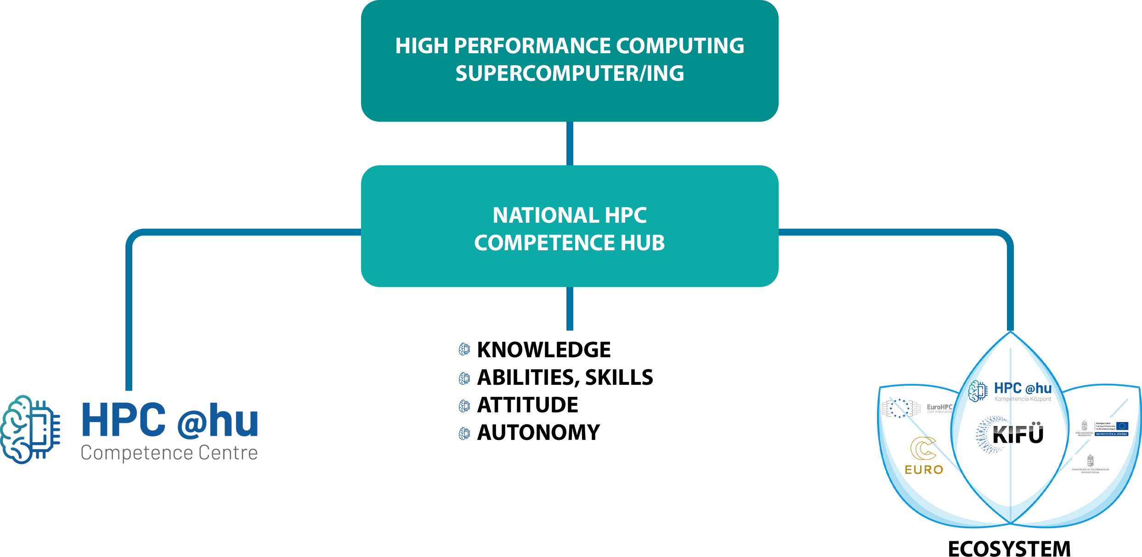

Slide 4
The KIFÜ Linking the knowledge and the needs of the academic sector with the knowledge and the needs of the industrial sector and creating the right environment ensure open resources at serving the digitalization in Hungary
Managed by the KIFÜ, the Hungarian HPC NCC can become a modern scientific HUB, adapting to the needs of the modern age
VISION
MISSION

Slide 5
TRAINING PLAN 2022
Training event | Level
Introduction to HPC Workshop | Beginner
Introduction to HPC | Beginner
OpenMP | Intermediate
AI I. Machine learning, deep learning | Intermediate
AI II. Training in the practical application of AI methods | Intermediate
GPU programming | Advanced
Training related to HPC software | Advanced
Detailed introduction to Komondor | Advanced

Slide 6
Thank you for your attention!
hpc.kifu.hu hpc@kifu.gov.hu @HPC.CC.hu
@HPC_hu

