Slide 1
Gyógyszertervezési eljárások fejlesztése a KIFÜ HPC-vel
Hetényi Csaba, Zsidó Balázs Zoltán, Börzsei Rita, Szél Viktor, Bayarsaikhan Bayartsetseg, Horváth István
Pharmacoinformatics Unit, Department of Pharmacology and Pharmacotherapy, Medical School, University of Pécs, Szigeti út 12, 7624 Pécs, Hungary.
hetenyi.csaba@pte.hu

Slide 2
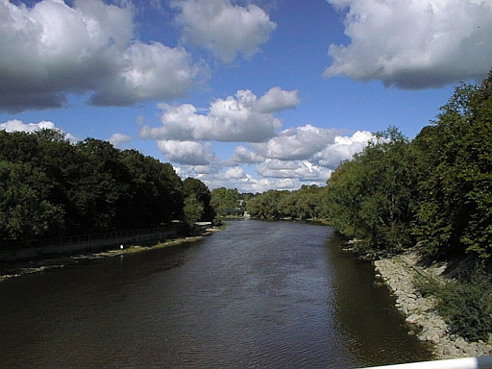
Hydration - Importance

Slide 3
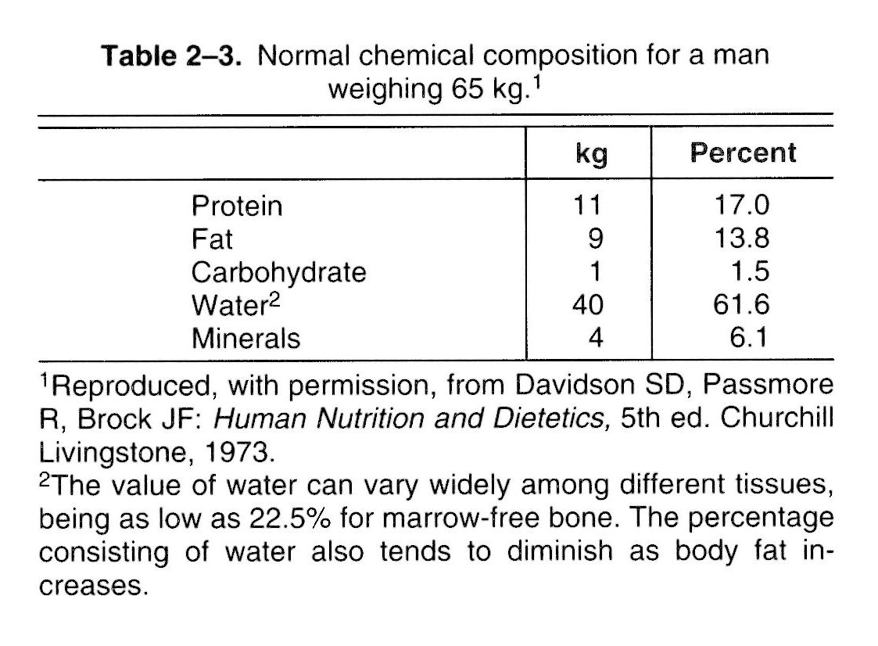

Slide 4
structural roles
- space filling, distance keeping
bridging, gluing
lubricating
dynamics (mobility!)
energetical roles
thermochemistry (reactant/product)
shielding (force fields)
heat conservation (large Cp)
heat transfer (via dynamics)
dissipation
etc.
Water

Slide 5
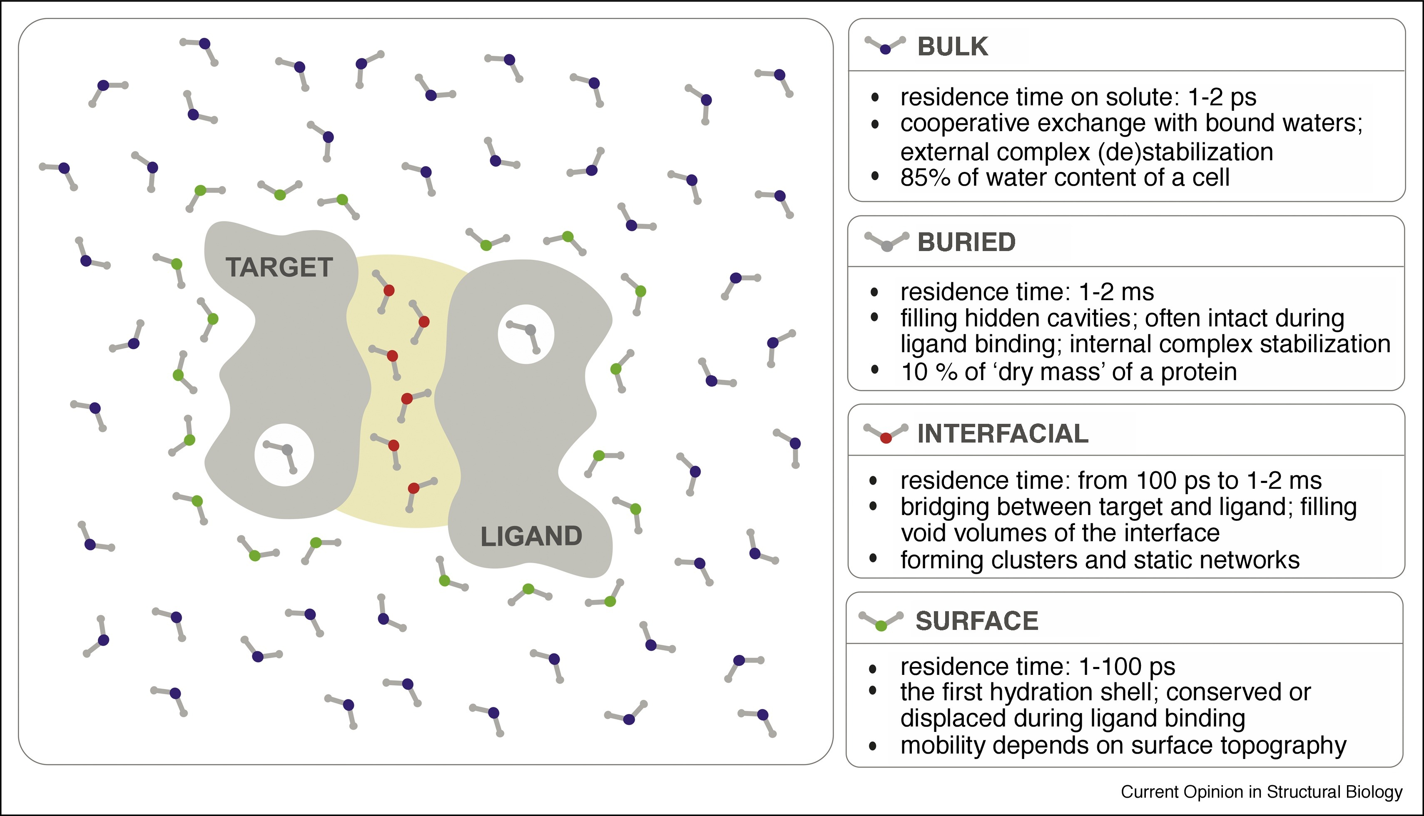
Hydration structure - categories
Balázs Zoltán Zsidó, Csaba Hetényi
The role of water in ligand binding
Current Opinion in Structural Biology
Volume 67, 2021, Pages 1-8

Slide 6
Hydration – Problems

Slide 7
Hydration structure - experimental problems
X-ray crystallography:
assignation of electron density peaks to possible interface water positions is still not a routine job due to inherent mobility of water and high number of degrees of freedom
quality of a solved structure depends on molecular size
electron density peaks of water are generally smaller than those of the surrounding (protein) interface
protein hydration in the crystal is not the same as in solution, for small proteins, 30–40% of the solvent-accessible surface is usually buried at crystal contacts
assignation of electron densities to water molecules is often performed to improve the fit of data during structural refinement. Misleading identification of water sites at this stage was found to be a bad practice
cryocrystallography used for protection of the protein molecules from damages caused by high energy synchrotron beams suffer from structural cryo-artefacts
NMR: special approaches are necessary (not discussed here)

Slide 8
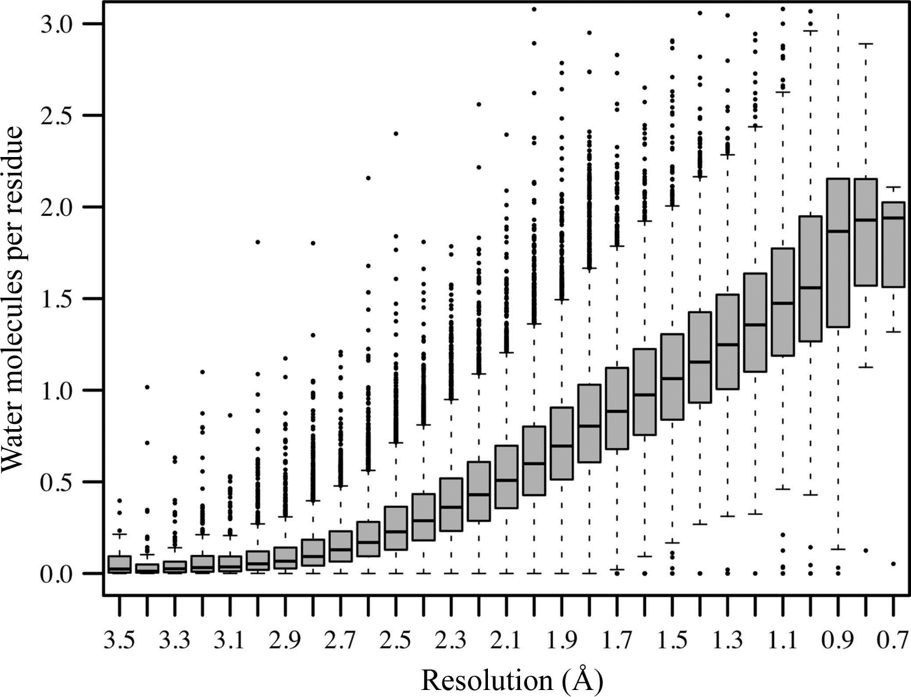
C.X. Weichenberger, P.V. Afonine, K. Kantardjieff, B. Rupp,
The solvent component of macromolecular crystals,
Acta Cryst. D Biol. Cryst. D71 (2015) 1023–1038.

Slide 9
The root of problems
„An unusually long residence time for a hydration water molecule, therefore, does not indicate particularly strong protein–water interactions, but rather a topography that prevents the water molecule from exchanging by a cooperative mechanism. The simplest example of such restrictive topography is a deep pocket on the protein surface.”
(Halle, B., 2004, Protein hydration dynamics in solution: a critical survey. Phil. Trans. R. Soc. Lond. B, 359, 1207-1224.)

Slide 10
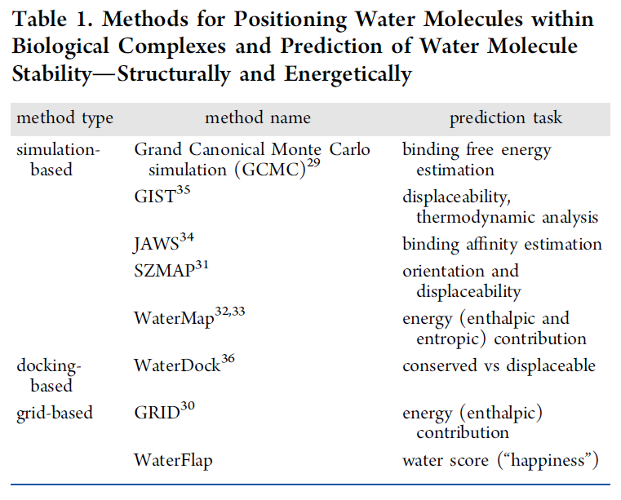
Hydration structure - modeling techniques
E. Nittinger, N. Schneider, G. Lange, M. Rarey, Evidence of water molecules - a statistical evaluation of water molecules based on electron density,
J. Chem. Inf. Model. 55 (2015) 771-783.

Slide 11
Problems of modeling techniques
Only target-water contacts are considered
Water-water contacts are missing
Lack of extensive validation
Few molecular dynamics (MD) approaches

Slide 12
Hydration – Our solution for the problem

Slide 13
A solution for the problems
MD with explicit solvent
Accounts for water mobility and residence time, not only binding strength

Slide 14
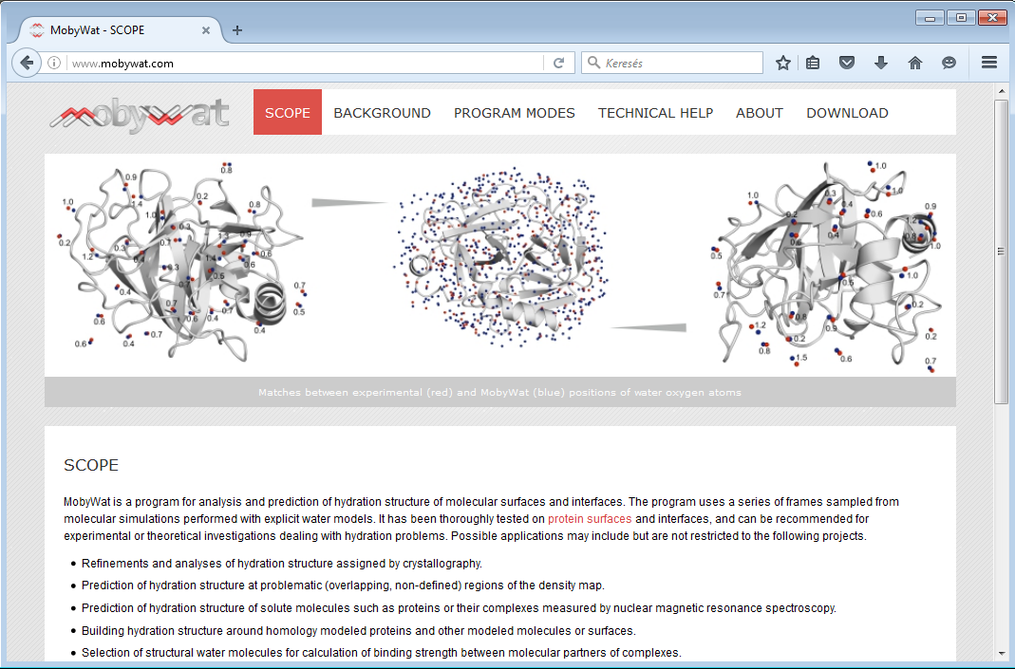
www.mobywat.com
Jeszenői N, Horváth I, Bálint M, van der Spoel D, Hetényi C*. (2015) Mobility-based prediction of hydration structures of protein surfaces.
Bioinformatics 31, 1959-65

Slide 15
Hydration of the drug-target interface
Jeszenői N, Bálint M, Horváth I, van der Spoel D, Hetényi C*. (2016) Exploration of interfacial hydration networks of target-ligand complexes. J Chem Inf Model 56, 148-58

Slide 16
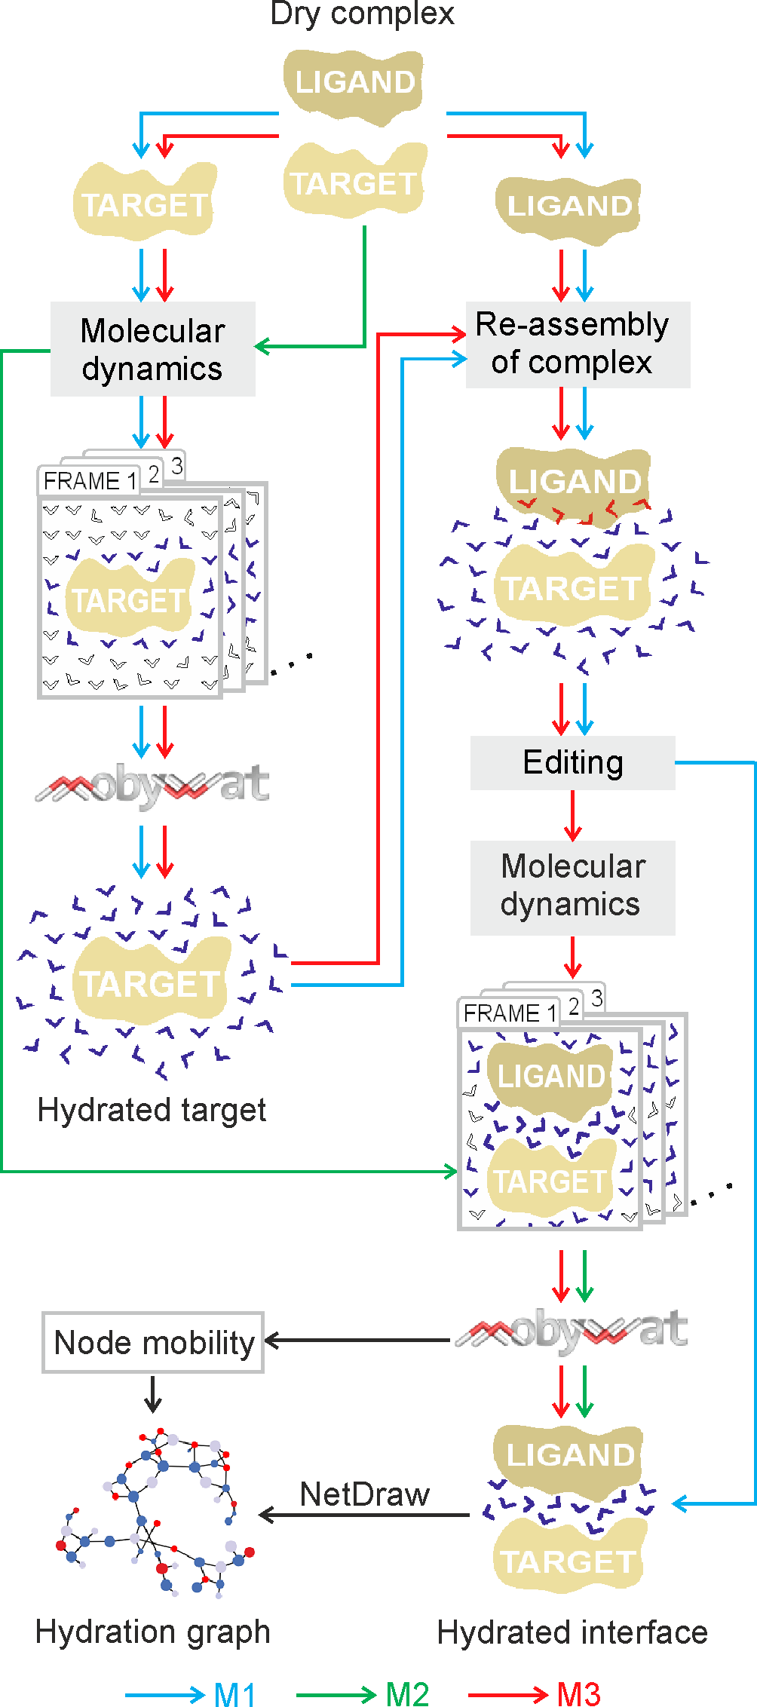
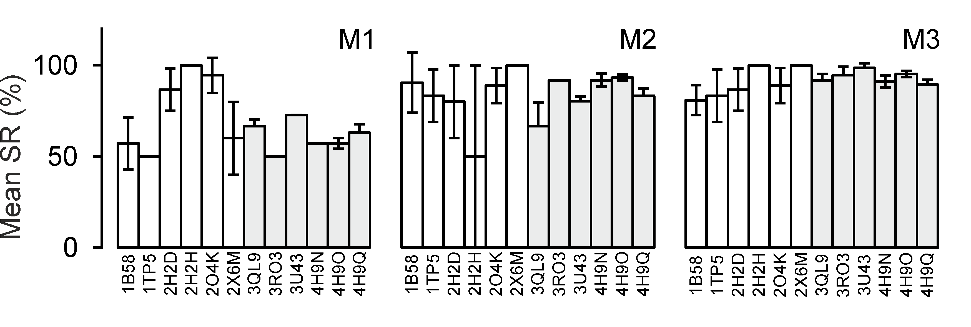
The tool was applied to thirty-one complexes including histone proteins, a HIV-1 protease, a G-protein-signaling modulator, and peptide ligands of various lengths.
The complexes contained 344 experimentally determined water positions used for validation, and excellent agreement with these was obtained.

Slide 17
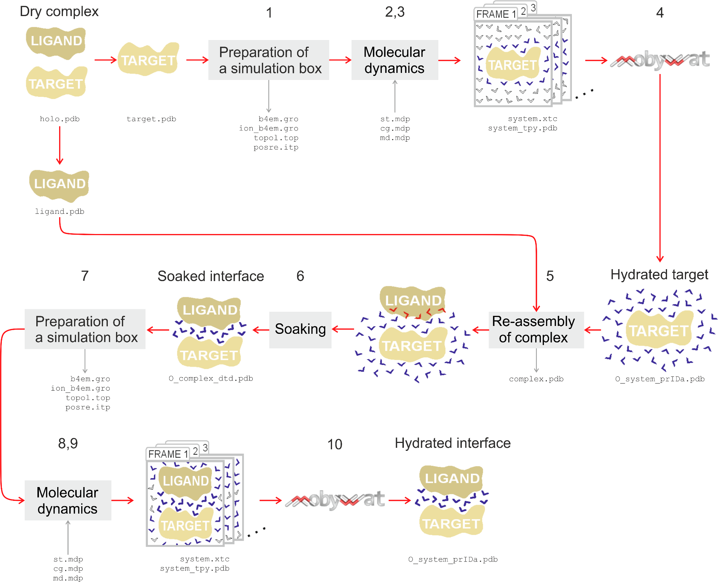
M3

Slide 18
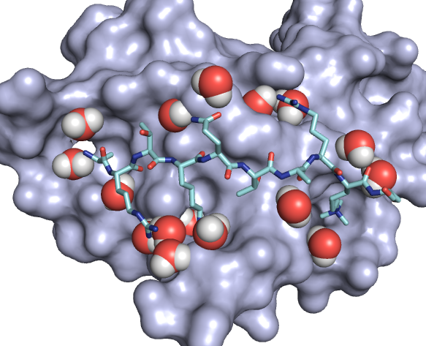
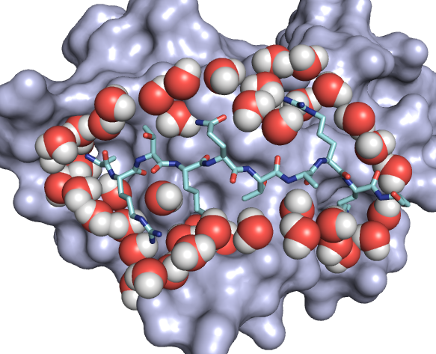
Experiment vs. Computation (3QL9)
Crystallographic
Cavities!
Computed by MobyWat
No cavities.
Transcriptional regulator ATRX bound to histone H3K9me3 peptide

Slide 19
Application 1
Calculation of drug-target binding enthalpy

Slide 20
Drug-target interaction
G: Gibbs free energy
H: enthalpy
S: entropy
K: equilibrium binding constant
R: gas constant
T: thermodynamic temperature (K)

Slide 21
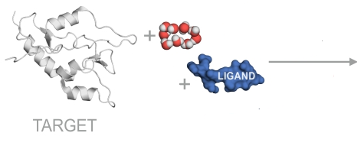
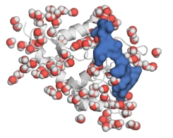
Calculation of binding enthalpy
Hess’s law

Slide 22
Difficulty of enthalpic optimization
„The enthalpy change associated with the interaction between drug and protein is difficult to optimize because it is composed of two major conflicting contributions: the favorable enthalpy associated with the formation of hydrogen bonds and van der Waals contacts and the unfavorable enthalpy associated with the desolvation of polar groups.”
(Freire E, 2008, Drug Discovery Today, Volume 13, Issues 19–20, Pages 869-874)

Slide 23
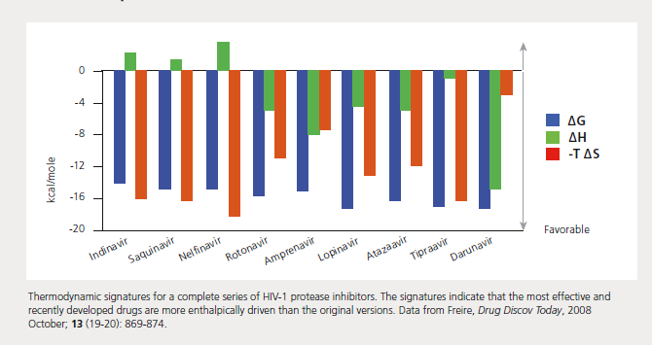
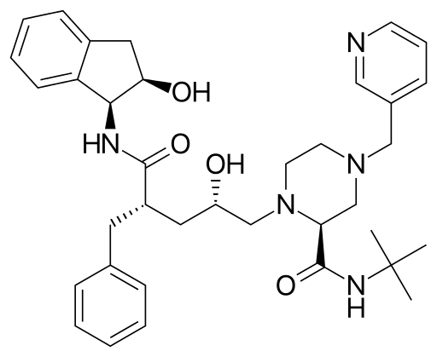
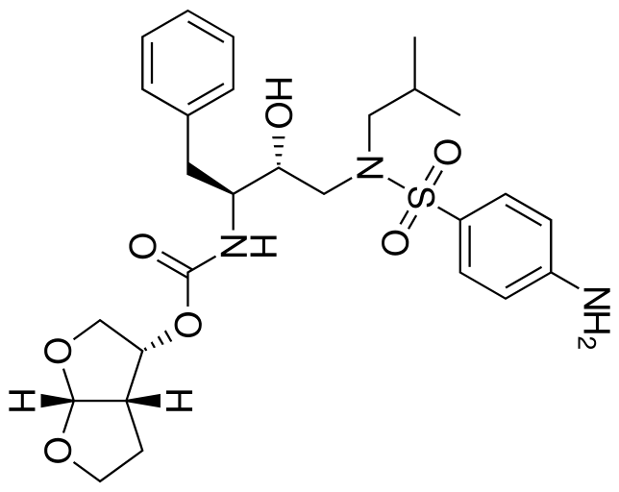
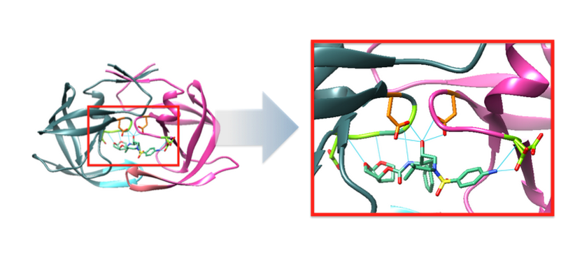
Enthalpic optimization of drugs
Indinavir
Darunavir

Slide 24
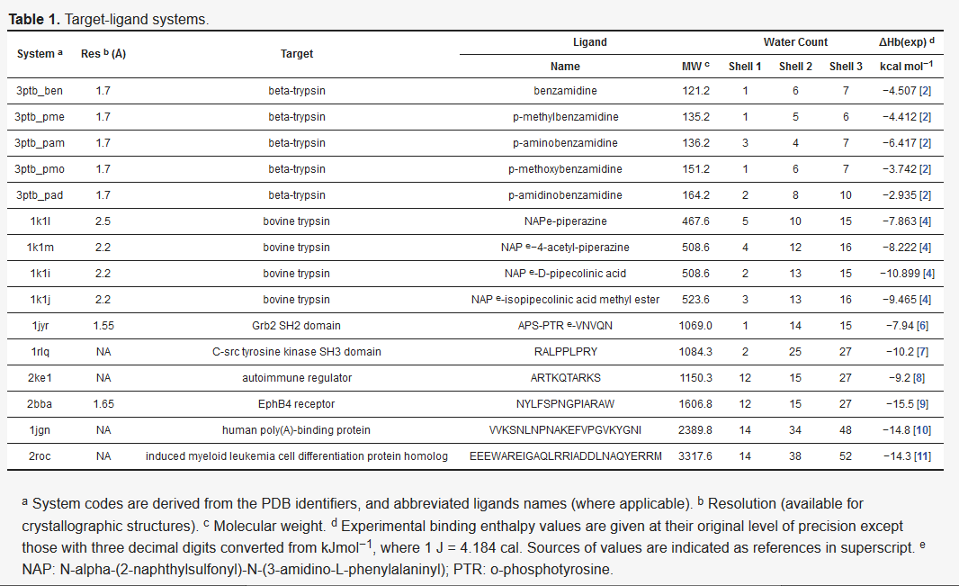
Binding enthalpy from heat of formation
∆H_{b} (exp)

Slide 25
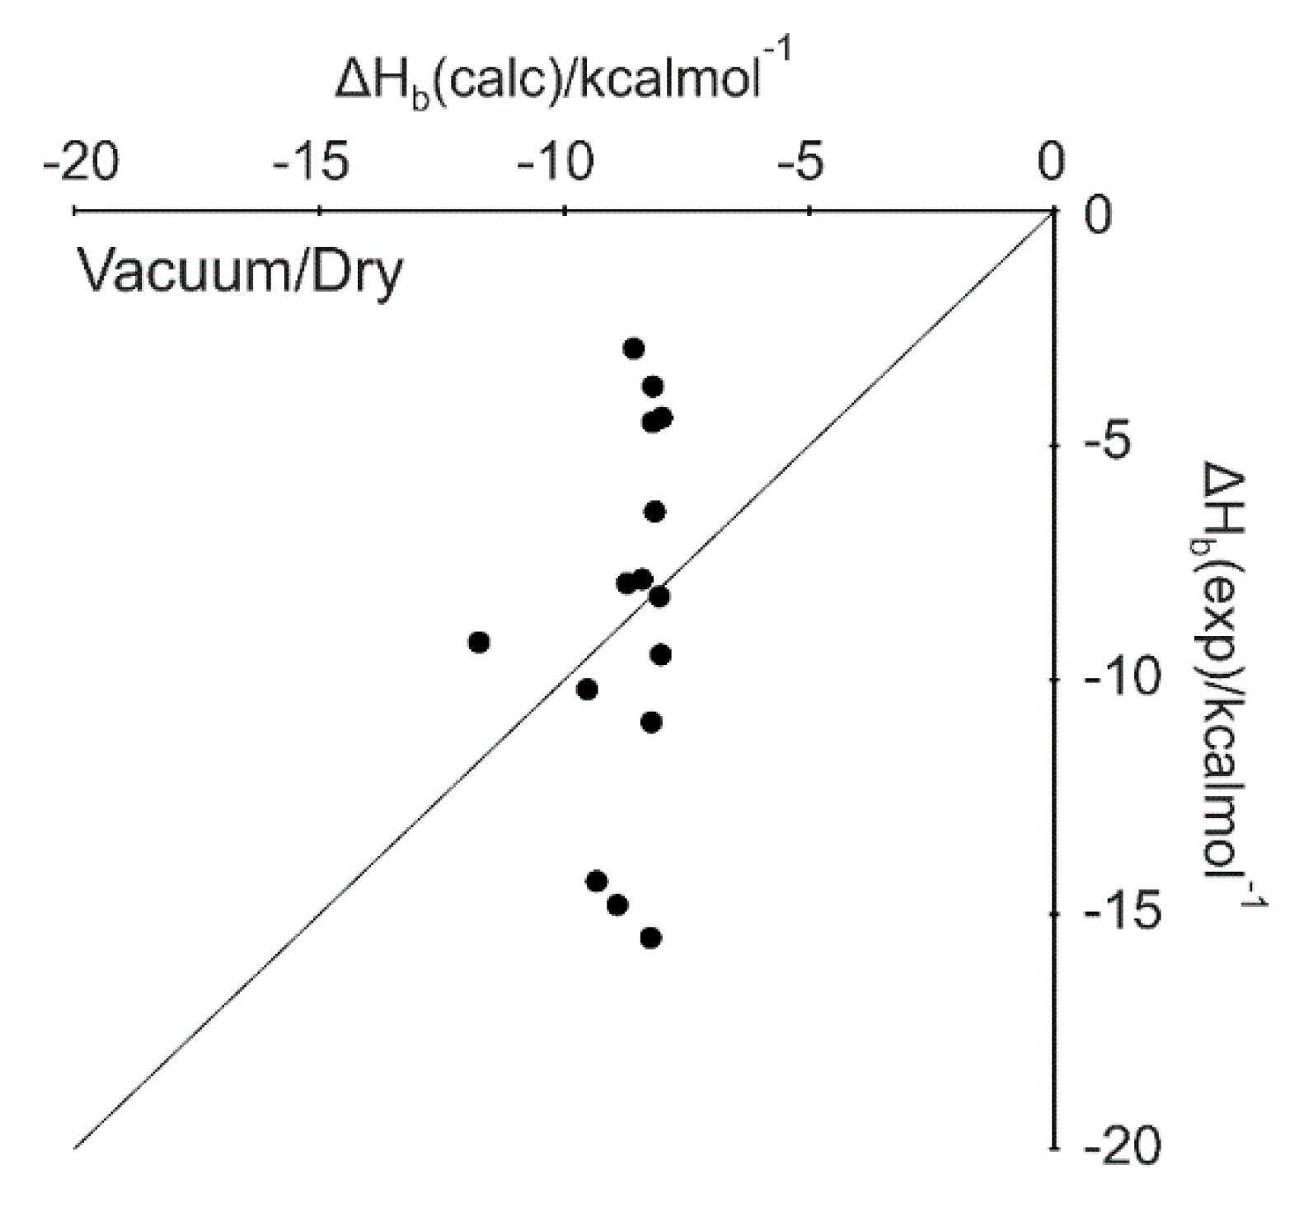
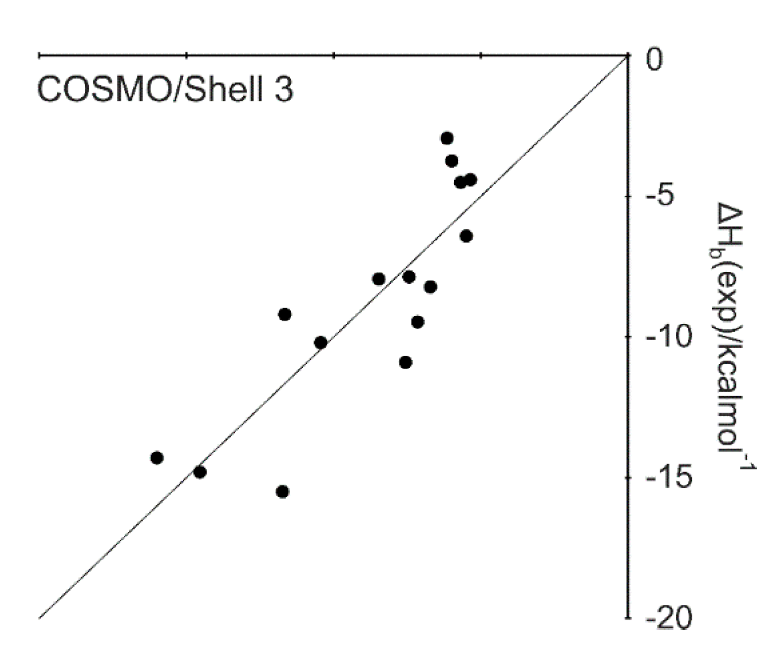

Slide 26
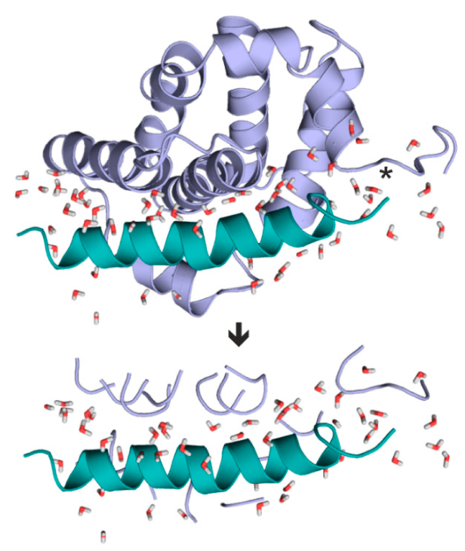
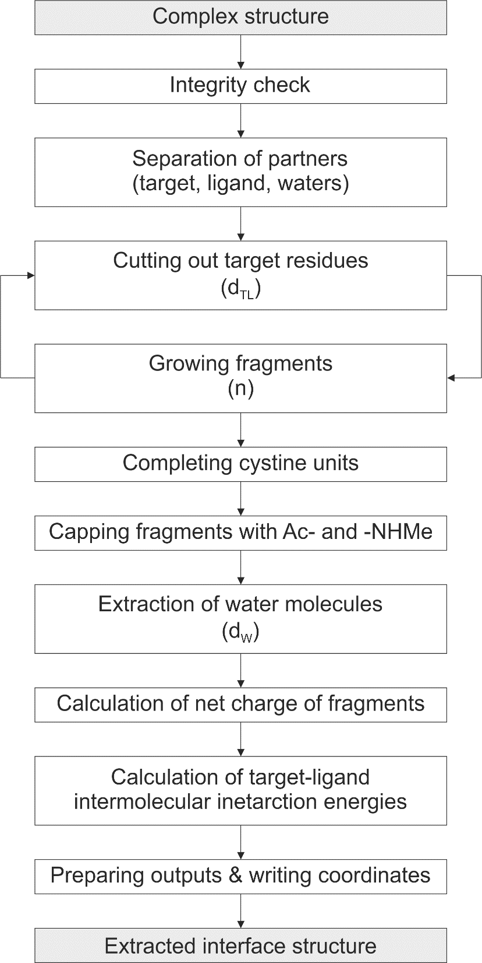
Fragmenting
Induced myeloid leukemia cell differentiation protein Mcl-1 homolog bound to p53-Inducible BH3-only protein Puma

Slide 27
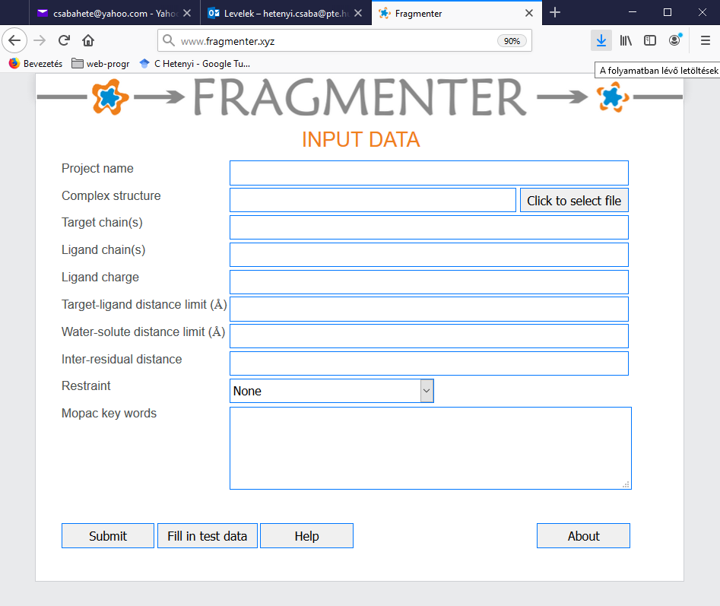
www.fragmenter.xyz
Horváth I, Jeszenői N, Bálint M, Paragi G, Hetényi C*. (2019) A fragmenting protocol with explicit hydration for calculation of binding enthalpies of target-ligand complexes at a quantum mechanical level
Int J Mol Sci 20(18), 4384

Slide 28
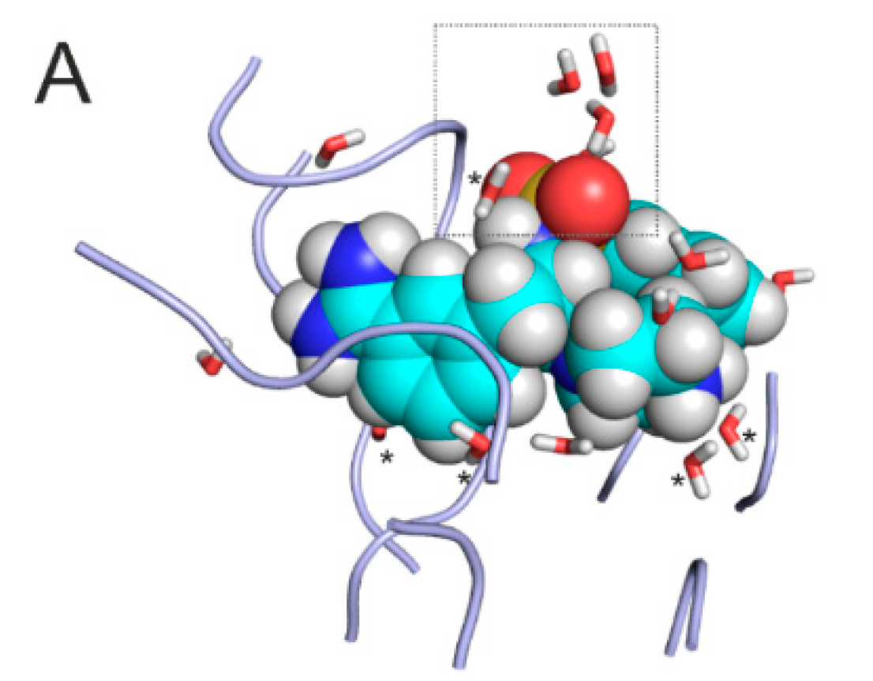
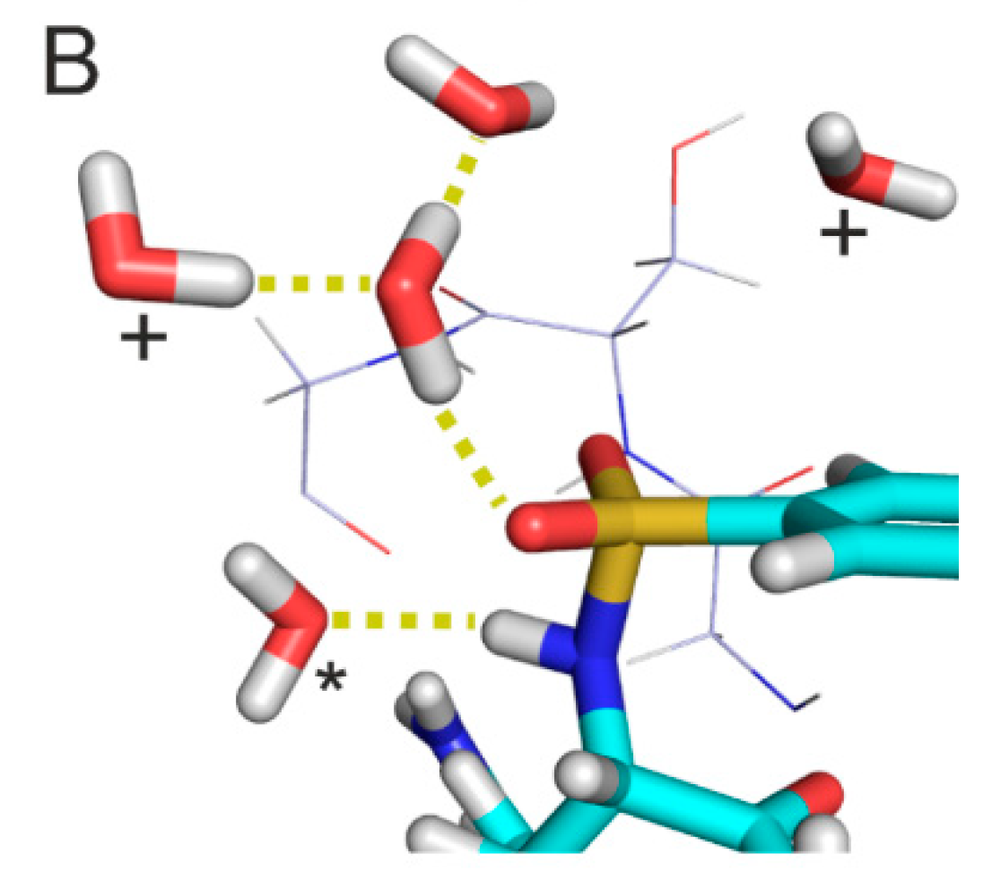
Effect of hydration
Extracted complex interface of System 1k1l. (A) Initial structure equipped with water molecules and energy-minimized at the molecular mechanics level. Target fragments and ligand are shown in ribbon and space filling representations, respectively. Water molecules in Shell 1 (dW = 3.5 Å, sticks marked with asterisk) are positioned close to the solute partners and play a bridging role. The rest of Shell 3 (dW = 5.0 Å) waters belong to Shell 2 (sticks without asterisks) and located at the edges of the interface, close to the bulk. Shell 3 = Shell 1 + Shell 2. (B) A rotated close-up of the box in Panel A showing the surrounding of the sulphonyl group of the ligand (sticks) and the neighboring residues G216SG218 of the target (lines) where the numbering follows that of the crystallographic structure (PDB ID 1k1l). Hydrogen bonds are marked with yellow dotted lines.

Slide 29
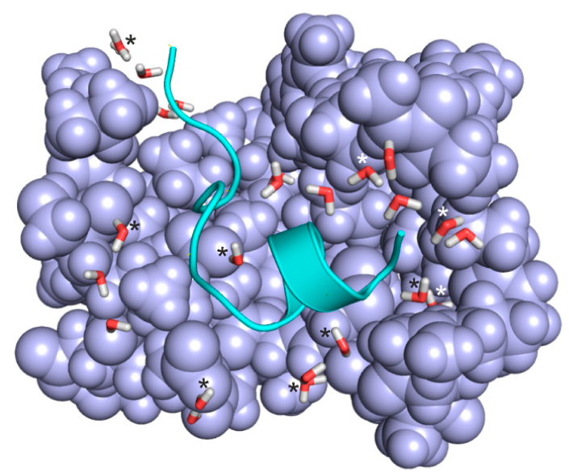
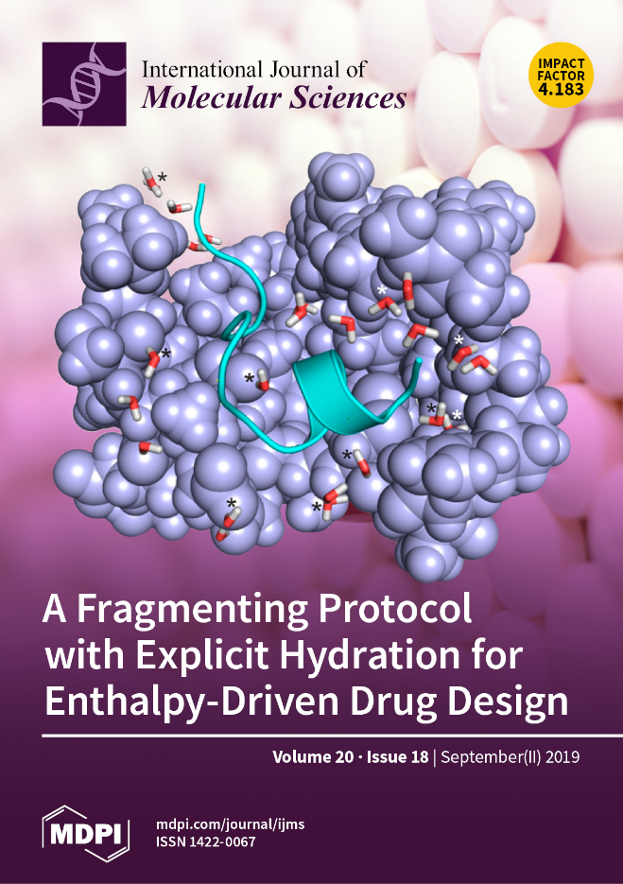
Large, peptide ligand
Extracted complex interface of System 2bba after relaxation at semi-empirical level using PM7 parameterization and Mozyme. Target fragments and ligand are shown in light blue space filling and green cartoon representations, respectively. Water molecules (sticks) in Shell 1 are marked with asterisks. Non-marked waters belong to Shell 2.

Slide 30
Application 2
Development of antiviral ligands – SARS-CoV-2

Slide 31
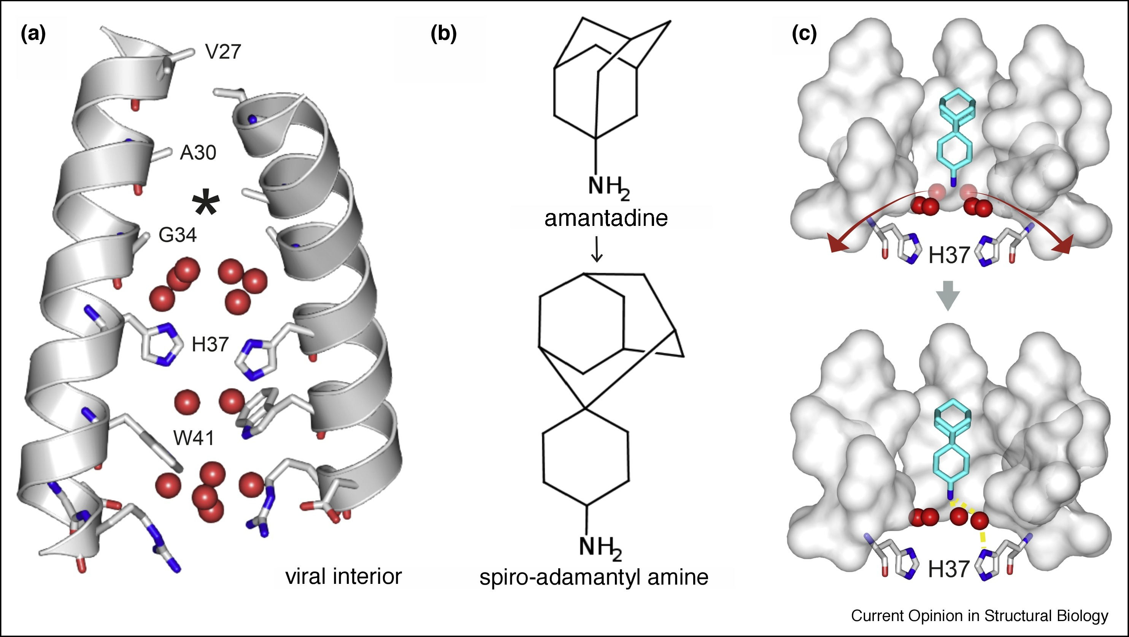
Influenza
Conserved and displaced water molecules during binding of spiro-adamantyl amine in the influenza M2 transmembrane (TM) proton channel.
J.L. Thomaston, N.F. Polizzi, A. Konstantinidi, J. Wang, A. Kolocouris, W.F. Degrado, Inhibitors of the M2 proton channel engage and disrupt transmembrane networks of hydrogen-bonded waters, J Am Chem Soc, 140 (2018), pp. 15219-15226

Slide 32
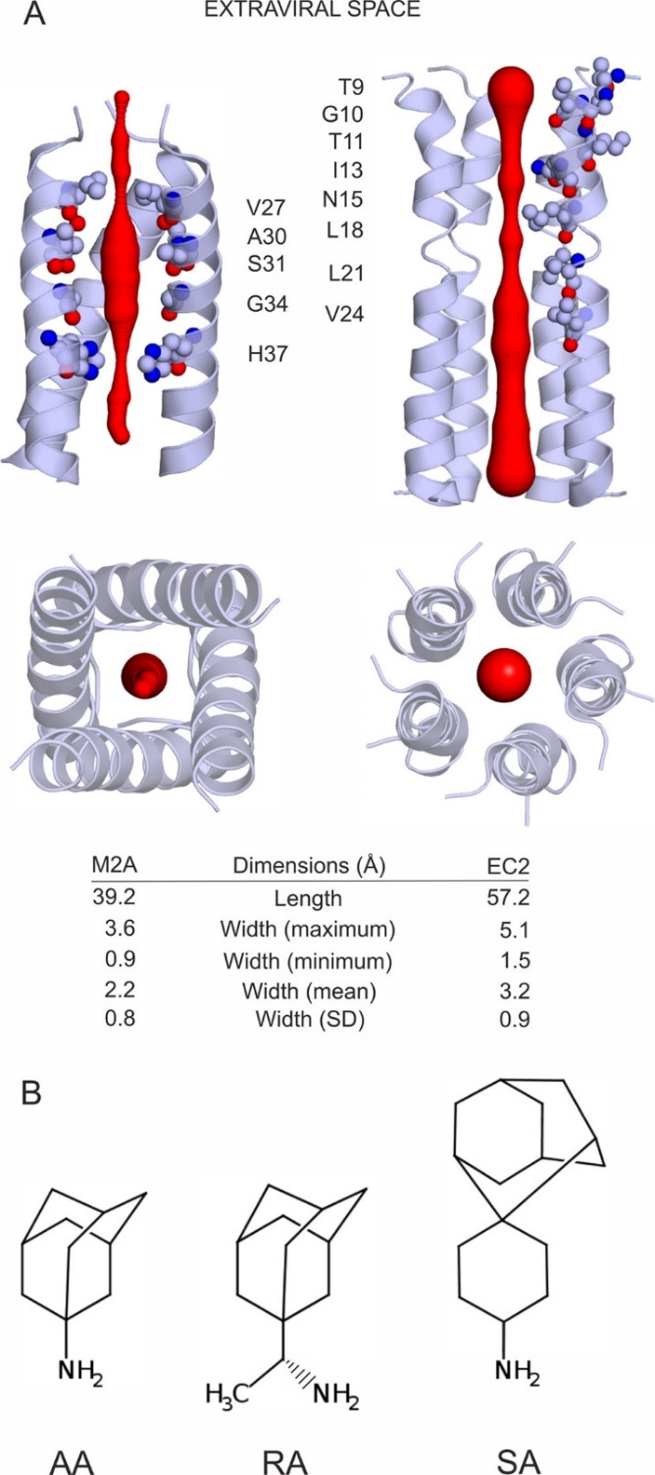
Influenza
SARS-CoV-2

Slide 33
HydroDock
Determination of Ligand Binding Modes in Hydrated Viral Ion Channels to Foster Drug Design and Repositioning
Balázs Zoltán Zsidó, Rita Börzsei, Viktor Szél, and Csaba Hetényi
J. Chem. Inf. Model.
2021, 61, 8, 4011–4022

Slide 34
Influenza
M2 transmembrane (TM) proton channel
Representative binding modes of ligands (teal sticks for carbon atoms) (A) AA, (B) RA, and (C) SA in the complex with M2A (cartoon) produced by the HydroDock protocol. For comparison, crystallographic ligand binding modes (orange sticks for carbon atoms) are shown as references. Interacting M2A amino acids and water molecules are shown as sticks and labeled accordingly to the residue numbering of 6bkk.

Slide 35
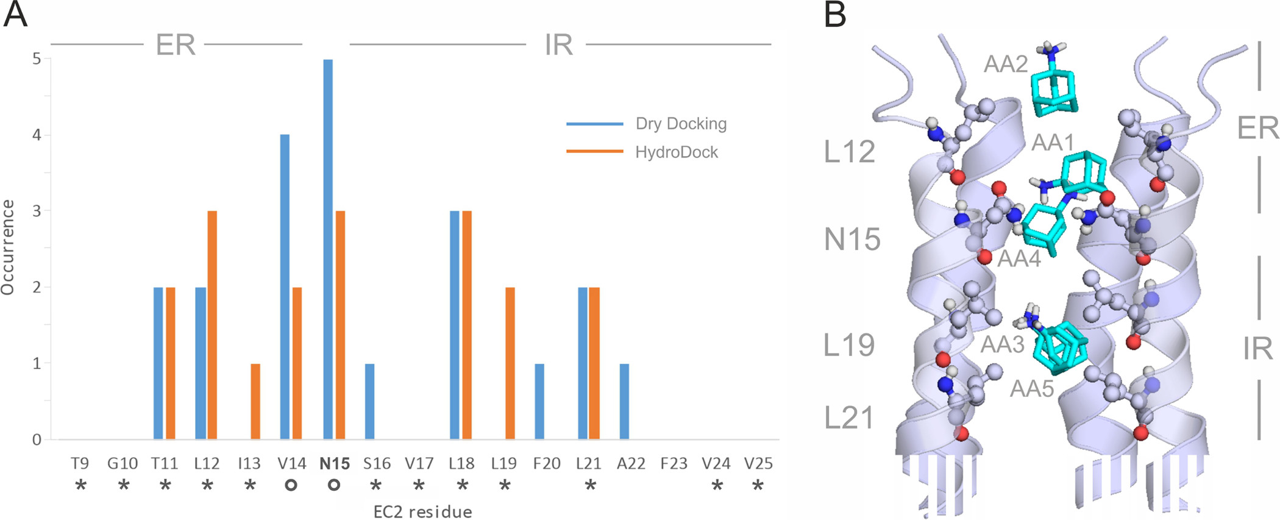
SARS-CoV-2
envelope protein (EC2)
(A) Occurrence of EC2 amino acids interacting with AA in the five binding modes (bars) produced by dry docking (blue bars) and after refinement by HydroDock (orange bars). Asterisks and circles indicate interacting amino acids identified by experiments and docking calculations, respectively, in a previous paper. Entrance and intrachannel binding regions are marked as ER and IR, respectively, at the top of the diagrams. (B) Five representative structures of binding modes AA1, ..., AA5 (teal sticks) on EC2 (cartoon, truncated at the bottom). The interacting EC2 amino acids are shown as balls and sticks and labeled by their identifiers according to PDB structure 7k3g. ER and IR binding regions are also shown on the right side of the figure.

Slide 36
Acknowledgements
This work was funded by the Hungarian National Research, Development and Innovation Office (K123836), 2017-1.2.1 NKP-2017-00002 (NAP-2; Chronic Pain Research Group), EFOP-3.6.1.-16-2016-0004 and GINOP 2.3.2-15-2016-00050 “PEPSYS”. This work was supported by the János Bolyai Research Scholarship of the Hungarian Academy of Sciences. We acknowledge the support from the Governmental Information Technology Development Agency, Hungary. The work was supported by the ÚNKP-21-5 and ÚNKP-21-3-II. New National Excellence Program of the Ministry for Innovation and Technology. Supported by the PTE ÁOK-KA 2021/KA-2021-39. The project has been supported by the European Union, co-financed by the European Social Fund. Project name and code: Comprehensive Development for Implementing Smart Specialization Strategies at the University of Pécs, EFOP-3.6.1-16-2016-00004. We acknowledge that the results of this research have been achieved using the DECI resource Archer2 based in the UK at the National Supercomputing Service with support from the PRACE aisbl.

Slide 37
KÖSZÖNÖM!
THANK YOU !
Please, visit our web sites of our free programs and services!
www.mobywat.com
www.fragmenter.xyz
www.wnsdock.xyz

